Slide 1
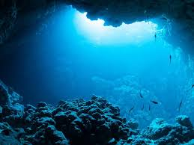
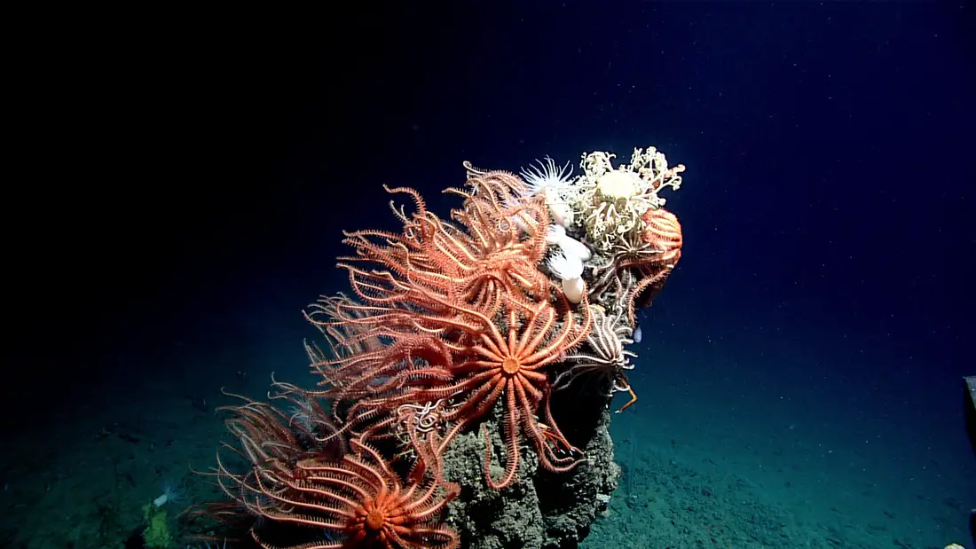
Deep Sea Image Classification
Cloud Computing
Jennifer Crosby
Benjamin Lee
Polly McKim
PMH

Slide 2
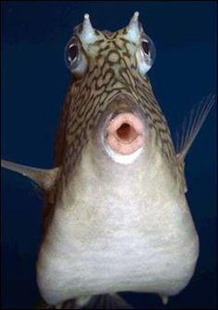

Problem Statement
Can we find cute photos like this?
Researchers currently spend thousands of hours sifting through countless photos to determine which ones have items of interest for their research. Can deep learning be used to solve this problem?
While filtering out photos like this?
BML

Slide 3

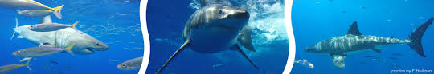
Project Overview
Acquired deep sea research expedition images from NOAA
Manually classified images as interesting or not based on creature presence
Built and deployed a machine learning model to learn to classify images based on their content labels
Used AWS architecture to greatly increase speed and scalability of the model
Delivered a model of over 75% accuracy
Used a CNN (convolutional neural network) algorithm as our model
BML

Slide 4


Sources Used
NOAA repository of deep sea images
CVision AI (http://cvisionai.com/) houses NOAA images on an online server
1500 images + additional created through image augmentation
PM

Slide 5


Libraries & Features Implemented
Python libraries to install:
Pandas, numpy , matplotlib, sklearn, pytorch, pytorchvision, warnings,
PIL, image_folder, random
Features used in modeling:
CNN, Adam optimizer, back propagation
PM

Slide 6
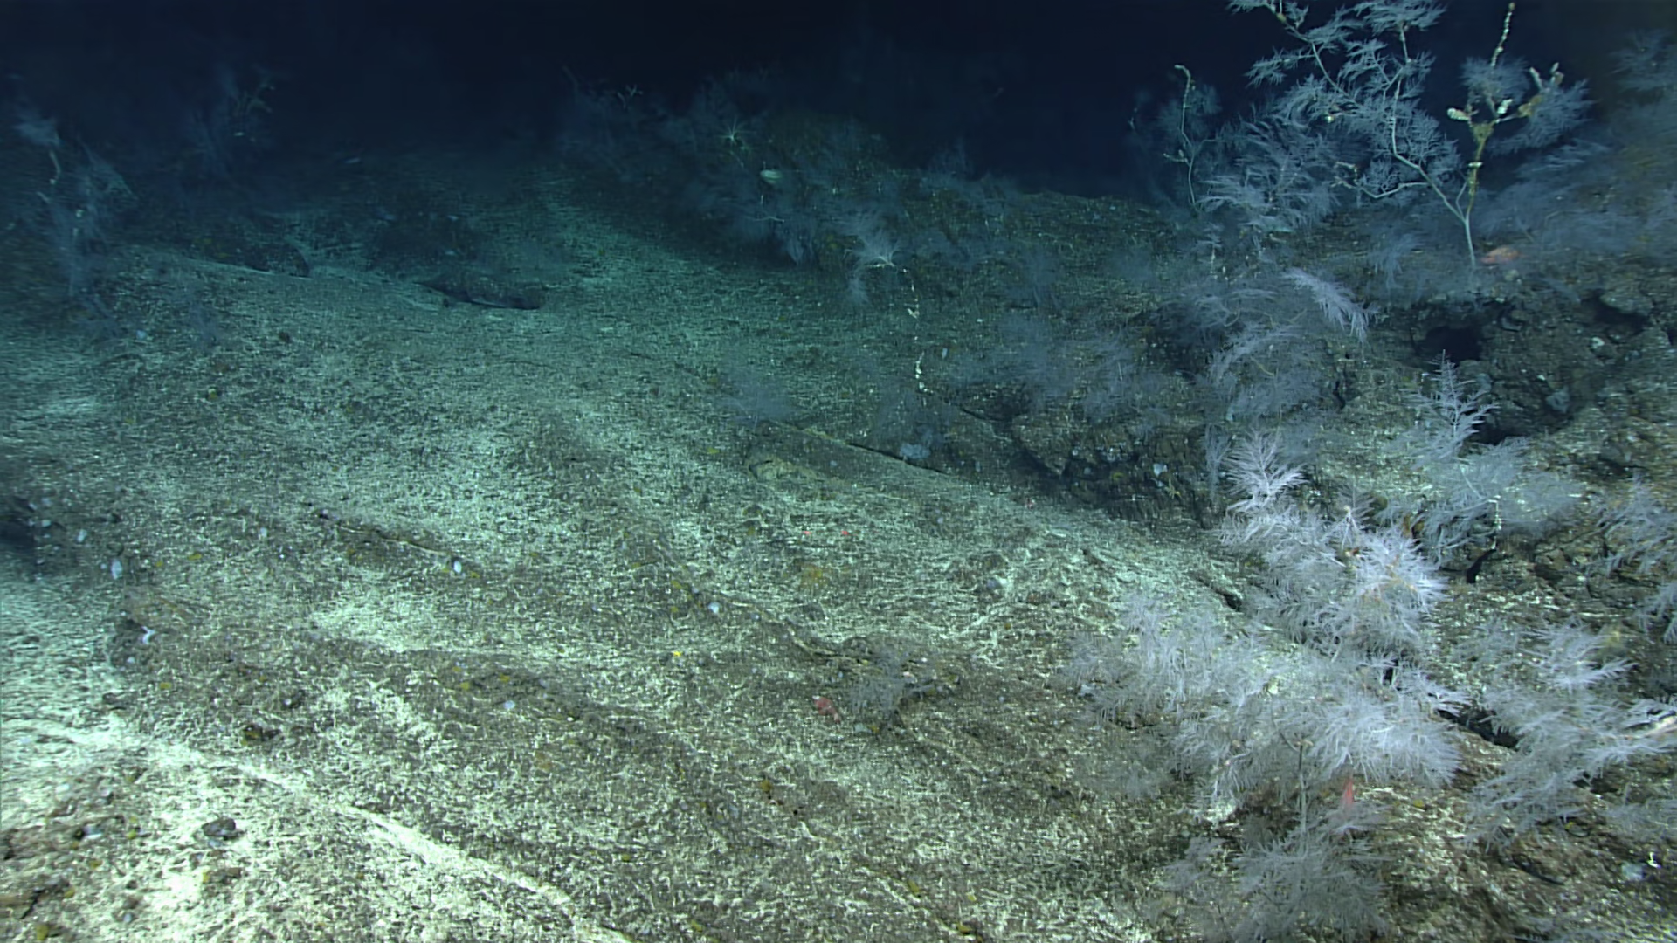
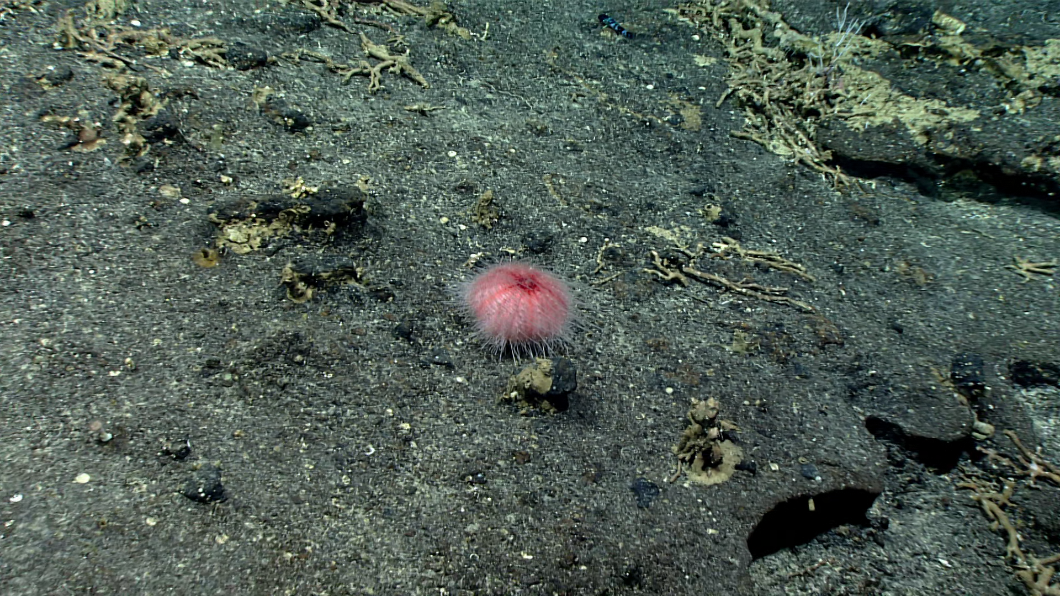
Examples of Inputs
Not Interesting
Interesting
PM

Slide 7
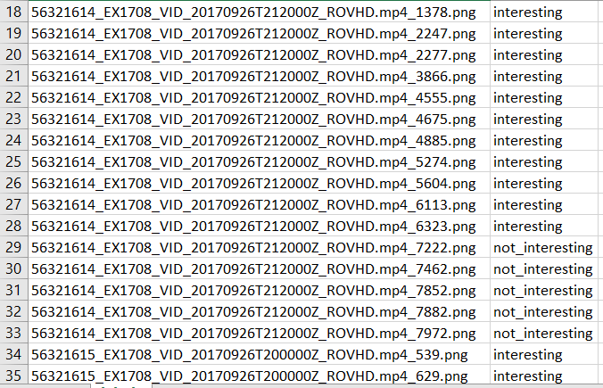
Target file
The 1500 images were manually classified
JKC

Slide 8


AWS Architecture Used for Project
EC2 (AMI Name Deep Learning Base AMI (Ubuntu 18.04) Version 31.0); Type: g3.4xlarge
VPC
AWS Cloud9- Cloud IDE
JKC

Slide 9
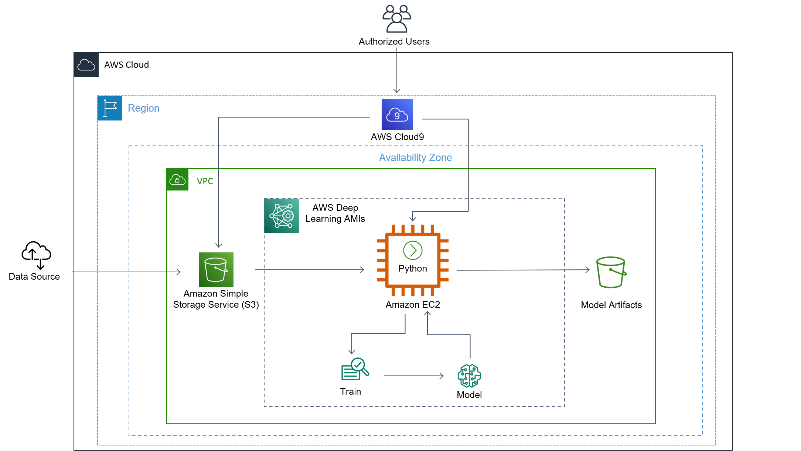
Architecture for Deep Learning EC2 Deployment
BML

Slide 10
Cloud Architecture Demo
JKC

Slide 11
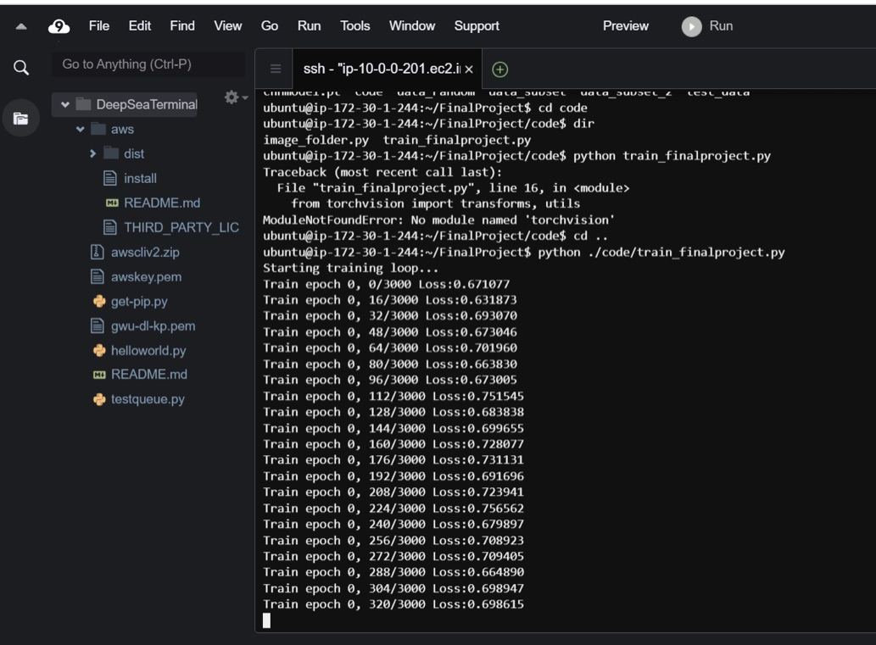
Python Running the Model on the
Deep Learning EC2
JKC

Slide 12
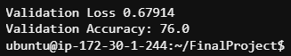
76%
Overall Accuracy Achieved
PMH

Slide 13
EC2 Deep Learning Findings & Cautionary Tales
G8, Ran much faster than on a typical personal computer. Ideal P3.
Auto Scalability or using more GPUs would likely have improved the run time even more but would have added to the cost of running the model. Need to make sure have limits available to implement.
Understanding of EC2 Ubuntu choices for deep learning is important (ie make sure the family you select has the capacity and features you need)
GPUs do not exist in all availability zones or on every option of deep learning Ubuntu (Don’t select a T when you really need a G or a P!).
In the future, the process would be simplified by figuring out how to feed the data directly from the S3 to the running python program on the EC2
JKC

Slide 14

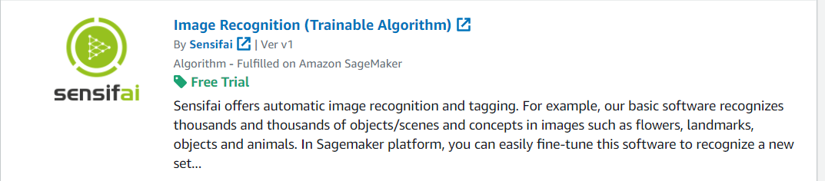
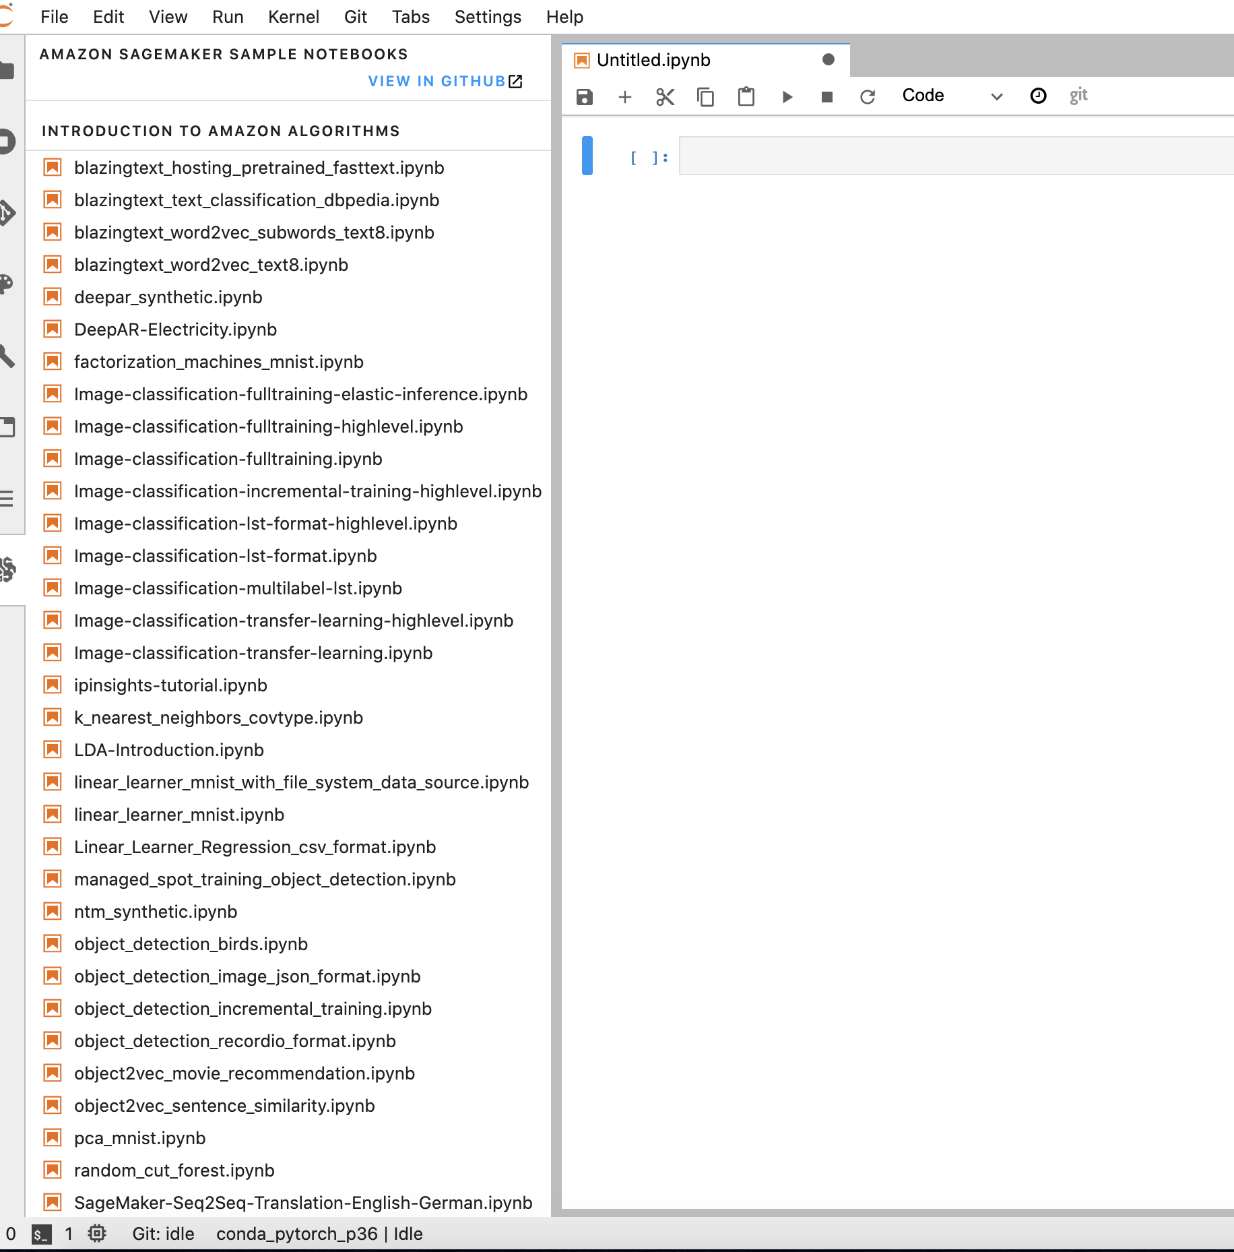
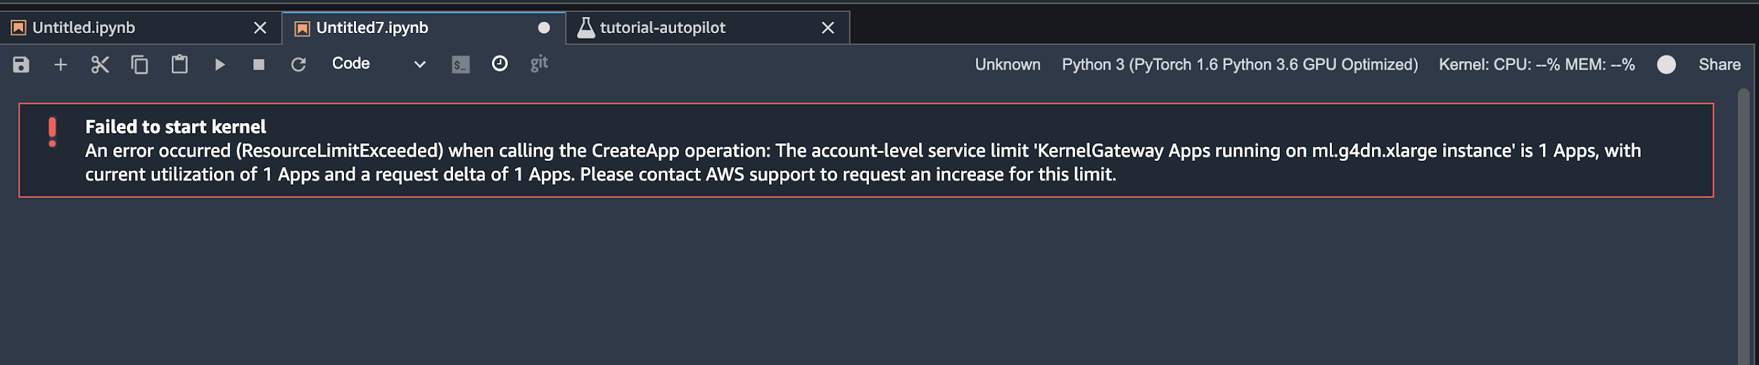
Sagemaker
Sagemaker Marketplace
Prefab Notebooks
Instance Limit Issues
PM & JKC

Slide 15
Sagemaker Findings & Cautionary Tales
Sagemaker notebooks/instances, like much of AWS, have predetermined blocks on certain kinds of notebooks so people don’t inadvertently run up a large bill
AWS is very slow to respond to requests to raise these limits
While Sagemaker worked well for smaller tutorial type models that we did to learn about the platform, we were unable to get adequate access to run a deep learning model within the sagemaker ecosystem
JKC

Slide 16
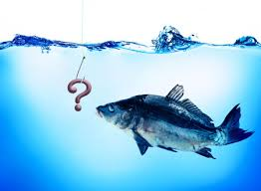
Questions?

